Slide 1

PHP
CHAPTER 5 – MVC & PROJECT STRUCTURE

Slide 2

OBJECTIVES FOR TODAY
Why do we need responsibilities in project ?
Be able to use the MVC pattern :
- The model
- The controller
- The view
Why do we need a clean PHP project structure
Be able to follow a clean structure

Slide 3


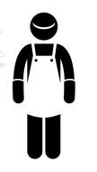


DISCUSS
3 responsibilities in a restaurant
10 MIN
Define their role ? What do they need to do ?
Why do we need to separate those responsibilities ?
CUSTOMER
WAITER
COOK

Slide 4
DISCUSS
What are the responsibilities of this code ?
10 MIN
(many answers possible)
A - Get data from database
B - Decide what the view should display (depending on the data)
C - Display the view
<?php
$statement = $connection->prepare("select * from posts");
$statement->execute();
$posts = $statement->fetchAll();
?>
<?php foreach($posts as $post): ?>
<li>
<?= $post['title'] ?> |
<span><?= $post['description'] ?></span> |
<a href="controllers/post/post.delete.controller.php?id=<?= $post['id'] ?>" >Delete</a> |
<a href="views/post/form.edit.view.php?id=<?= $post['id'] ?>">Edit</a>
</li>
<?php endforeach; ?>

Slide 5

EXPLAIN
Why do we need responsibilities ?
10 MIN
REAL LIFE PROJECT
IT PROJECTS
Participants know what to do
Developer know where to code
Eliminate duplication of work
Eliminate duplication of work
Clarify a work flow
Clarify a work flow
Help to check if things are done
Help to test the code

Slide 6

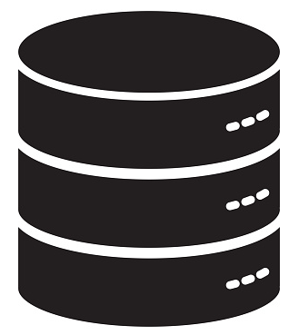

EXPLAIN
The MVC architecture
The CONTROLER Is in charge to provide the right data to the view
10 MIN
The CONTROLER can also validate user inputs, hide field, display warnings
SERVER
CLIENT
MODEL
CONTROLER
REQUEST
VIEW
RESPONSE

Slide 7
1 – The controller
Provide the right data to the view
Validate user inputs, hide field, display warnings
SERVER
CLIENT
MODEL
CONTROLER
REQUEST
VIEW
RESPONSE

Slide 8
2 – The model
Provide the data needed by the application
Changing the data : remove, insert, add..
SERVER
CLIENT
MODEL
CONTROLER
REQUEST
VIEW
RESPONSE

Slide 9
3 – The view
Build the user interface , given the information provided by the controller
SERVER
CLIENT
MODEL
CONTROLER
REQUEST
VIEW
RESPONSE

Slide 10
DEMO
The MVC architecture
10 MIN
$heading = "Post Page";
require 'models/post.model.php';
$posts = getPosts();
require "views/post/post.view.php";
post.controler.php
1 – Get data
function getPost(int $id) : array
{
global $connection;
$statement = $connection->prepare("select * from posts where id = :id");
$statement->execute([':id' => $id]);
return $statement->fetch();
}
post.model.php
2 – Call the view
<?php foreach($posts as $post): ?>
<li>
<?= $post['title'] ?> |
<span><?= $post['description'] ?></span> |
<a href="controllers/post/post.edit.controller.php?id=<?= $post['id'] ?>">Edit</a>
</li>
<?php endforeach; ?>
post.view.php
3 – Create the HTML from the data

Slide 11
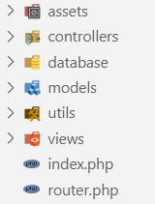
EXPLAIN
Clean project structure
Image, PDF, resources
All controllers
Connection to DB
All models
Utility functions : debug, file, URL operations
All views
The router to the controllers

Slide 12
EXPLAIN
File names
Use the same syntax in all project files
post.controler.php
post.remove.controler.php
name
responsibility
name
action
responsibility

Slide 13
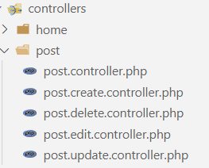
EXPLAIN
Controller structure
1 folder per main view
Main controller
Sub controller ( actions or sub views)

Slide 14
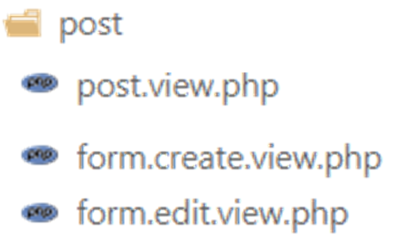
EXPLAIN
Views structure
1 folder per main view
Main view
Sub view

